Slide 1


PANIMALAR ENGINEERING COLLEGE
Department of Computer Science and Engineering
Project Review, 07.08.2021
Diseases Prediction Systems For Covid with Electronic Medical Records
BATCH NO:- F8
SASIDHAR.V.J (211417104247)
SARAVANA KUMAR.S (211417104245)
VIGNESH.E (211417104298)
Shanmugasundar.R(211417104264)
PROJECT GUIDE : MR.G.SENTHILKUMAR
ASSOCIATE PROFESSOR,CSE

Slide 2
INTRODUCTION
Electronic Health Records (EHR) are electronic records that help the physicians to access the patient’s records instantly, to keep track of patients’ due dates for checkups and immunisations and monitor patients health performance and make decisions accordingly.EHR data is an integral part of smart and mobile health care systems.Through EHRs, it is possible to maintain patients data as well as diagnose whether potential patients are with diseases. The software also Detects the presence of covid by uploading the Chest X-ray Scan of the patients

Slide 3
LITERATURE SURVEY
Title / Journal | Year | Description
Implementation and Use of Disease Diagnosis Systems for Electronic Medical Records Based on Machine Learning / IEEE Access | 2020 | This survey paper highlighted both the strength and weakness of various techniques using rule based, machine learning and deep learning based in disease diagnosis for electronic health records.
Automatic Detection of COVID-19 Infection Using Chest X-Ray Images Through Transfer Learning / IEEE Journal of Automatica Sinica | 2020 | The results of the paper shows that MobileNet combined with support vector machines (SVM) (Linear) achieved the highest accuracy (98.462%) in detecting COVID-19 using X-ray images

Slide 4
PROBLEM STATEMENT
So our project is to detect presence of COVID in a persons by uploading the person’s Chest X-ray scan and determine them quickly with a algorithm. Along with it we have developed a electronic medical records for storing and managing a small hospital .
This enables the patient to book a appointment with the Doctor through the System and doctor can manage to accept or reschedule.
The patients medical records such as Prescription can be Stored digitally in the system and can be accessed in a date wise manner.
It eases the relationship between a patient and Doctor in small clinics and helps patient to store the records digitally.

Slide 5
Software / Hardware used
MINIMUM 2GB RAM REQUIRED
PENTIUM CORE PROCESSING MACHINE
PHONE/TABLET/LAPTOP
STABLE INTERNET CONNECTION
Technologies used
KERAS,TENSORFLOW,CONVOLUTIONAL NEURAL NETWORK(CNN)
HTML5, JAVASCRIPT,CASCADING STYLE SHEET(CSS)

Slide 6
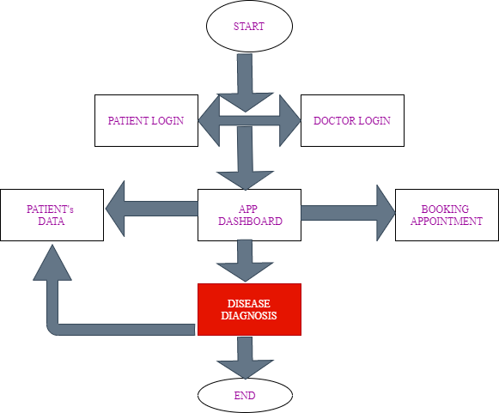
System Architecture
Fig 1: shows System Architecture of modules of disease prediction for covid with electronic health records

Slide 7
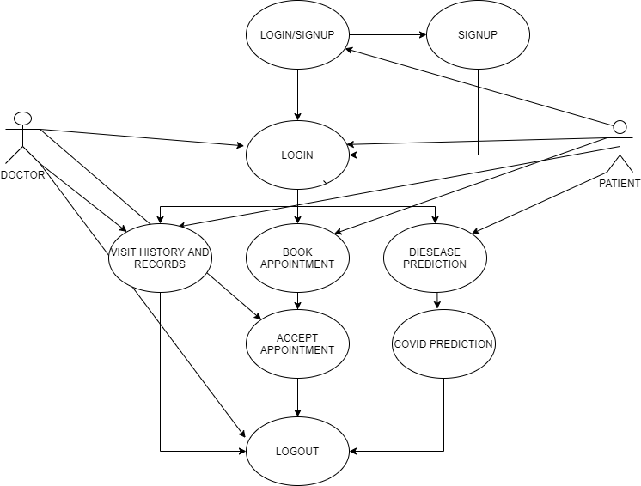
SYSTEM DESIGN USE CASE DIAGRAM
A use case diagram at its simplest is a representation of a user's interaction with the system that shows the relationship between the user and the different use cases in which the user is involved. A use case diagram can identify the different types of users of a system and the different use cases and will often be accompanied by other types of diagrams as well.

Slide 8
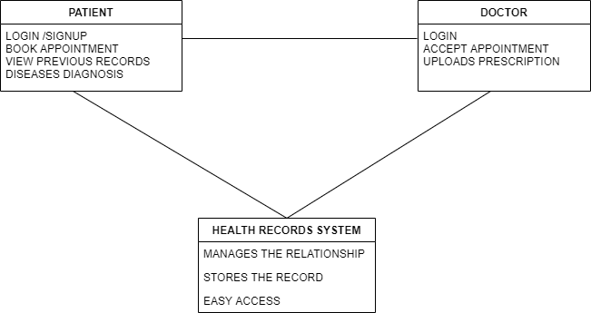
PACKAGE DIAGRAM
A package diagram, a kind of structural diagram, shows the arrangement and organization of model elements in middle to large scale projects. The package diagram can show both structure and dependencies between sub-systems or modules, showing different views of a system.

Slide 9
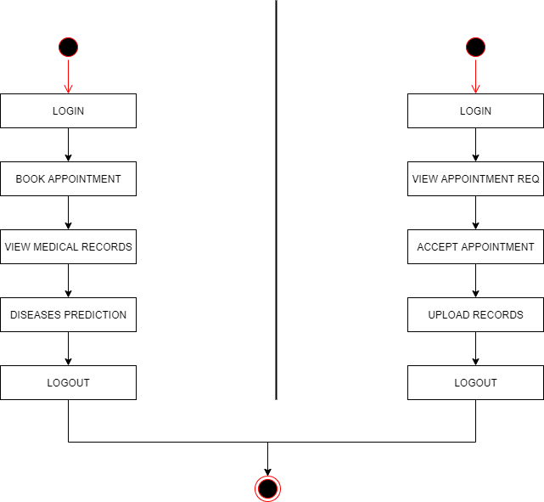
FLOW DIAGRAM
A diagram of the sequence of movements or actions of people or things involved in a complex system or activity.

Slide 10
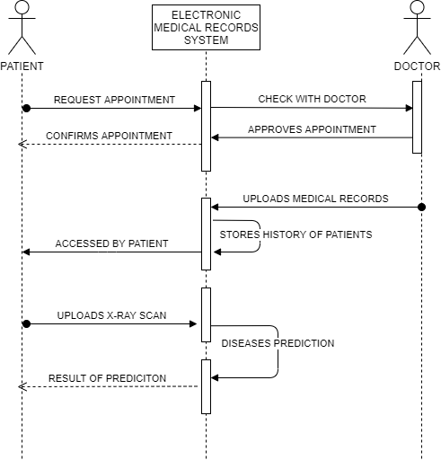
SEQUENCE DIAGRAM
A sequence diagram shows object interactions arranged in time sequence. It depicts the objects and classes involved in the scenario and the sequence of messages exchanged between the objects needed to carry out the functionality of the scenario. Sequence diagrams are typically associated with use case realizations in the sequence diagram of the system under development.

Slide 11
MODULE DESCRIPTION Convolution Neural Network (CNN)
A Convolutional neural network (CNN) is a neural network that has one or more convolutional layers and are used mainly for image processing, classification, segmentation and also for other auto correlated data. A convolution is essentially sliding a filter over the input.
This Neural network plays a major role in the Covid detection of the Chest X-ray scans it learns the difference between the healthy and Covid x-ray scans and predict the nature of given Input.

Slide 12
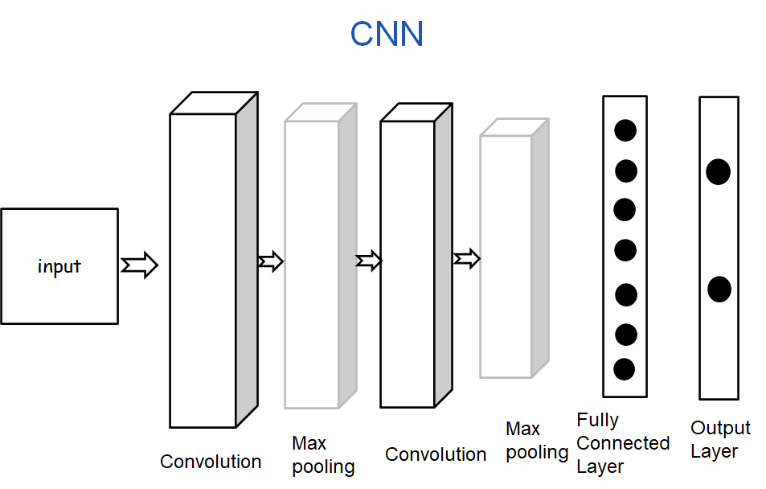
Fig 2: Shows the Working of CNN

Slide 13
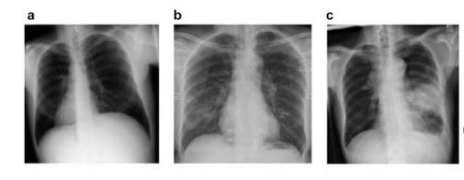
X-ray image Dataset
In this work, we used around 4200 chest X-ray images of COVID-19 obtained from the open-source GitHub repository, shared by Dr. Joseph Cohen, and the Covid-19 Radiography dataset. We also used the ChestX-ray8 database on no-findings and pneumonia images.
Below Figure 3 shows some examples of chest X-ray images from prepared dataset:
(a) Chest X-ray image of Normal patient
(b) Chest X-ray image of COVID-19 patient
(c)Chest X-ray image of Normal patient

Slide 14
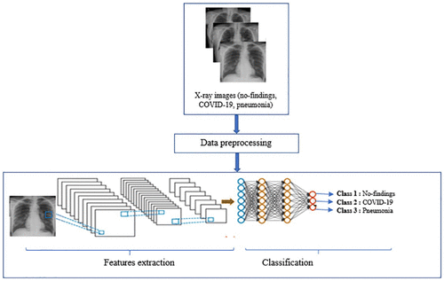
Materials and Methods
In this study, we propose a new CNN-based method of classifying COVID-19, pneumonia, and no-findings chest X-ray images.
Figure 4: shows the flow diagram of proposed method

Slide 15
RANDOM FOREST
As per the existing models, random forest gives the best accuracy among other algorithms. Hence, we will be using random forest classifier.
Random Forest is an ensemble learning method for classification and regression by constructing multiple decision trees in training and outputting the classification or prediction(regression). The goal of Random Forest is to combine weak leaning models into a strong and robust leaning model. From a tutorial online, we learn that the algorithm of Random Forest can be summarized in 4 steps:
Step 1:
Randomly draw M bootstrap samples from the training set with replacement.
Step 2:
Grow a decision tree from the bootstrap samples. At each node: Randomly select K features without replacement and split the node by finding the best cut among the selected features that maximizes the information gain.
Step 3:
Repeat the steps 1 and 2 T times to get T trees;
Step 4:
Aggregate the predictions made by different trees via the majority vote.

Slide 16
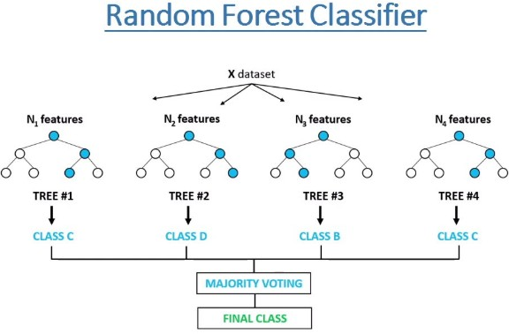
The hyper-parameters in random forest are either used to increase the predictive power of the model or to make the model faster. Let's look at the hyper-parameters of sklearns built-in random forest function

Slide 17
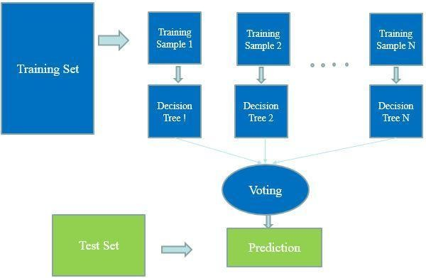
Figure 5: shows the random forest algorithm

Slide 18

TESTING
Fig 6: Shows the patient login checking

Slide 19

Fig 7:shows the doctor login checking

Slide 20

SCREENSHOTS
Fig 8: shows the homepage

Slide 21
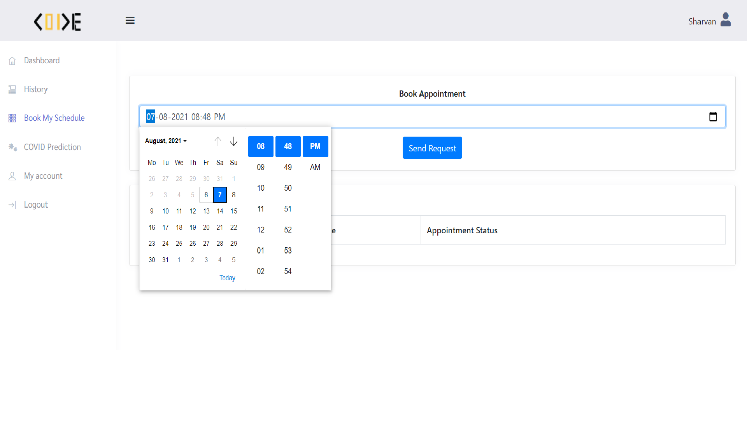
Fig 9 : shows appointment booking by patient

Slide 22
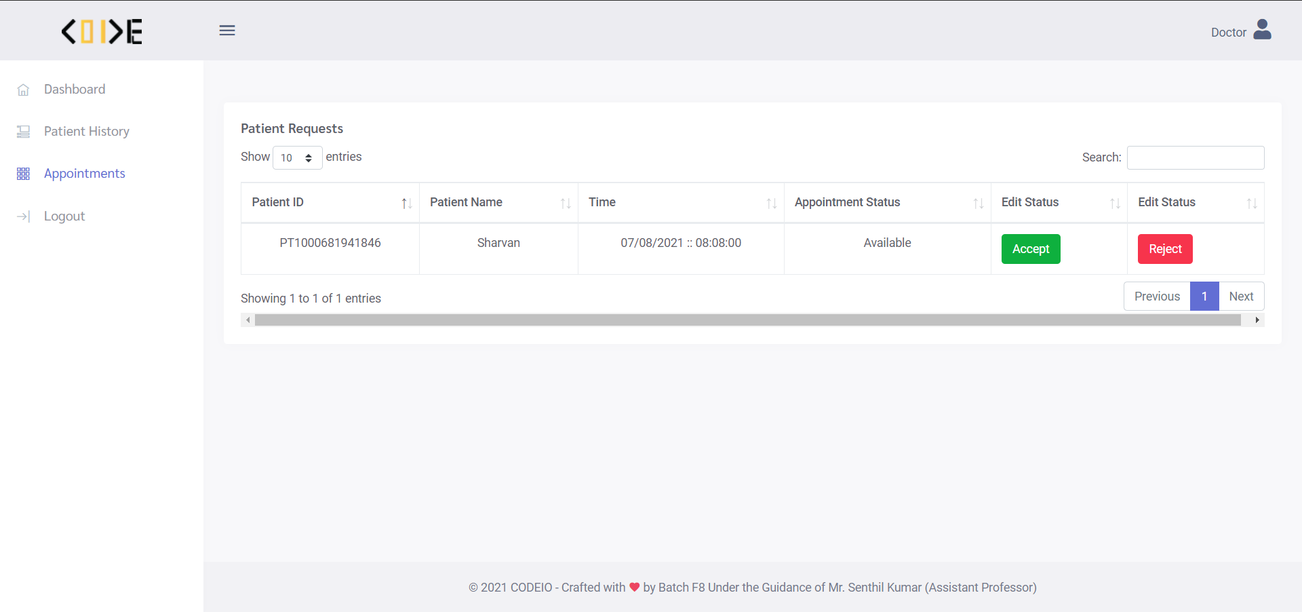
Fig 10: shows the confirmation screen in Doctor’s Login

Slide 23
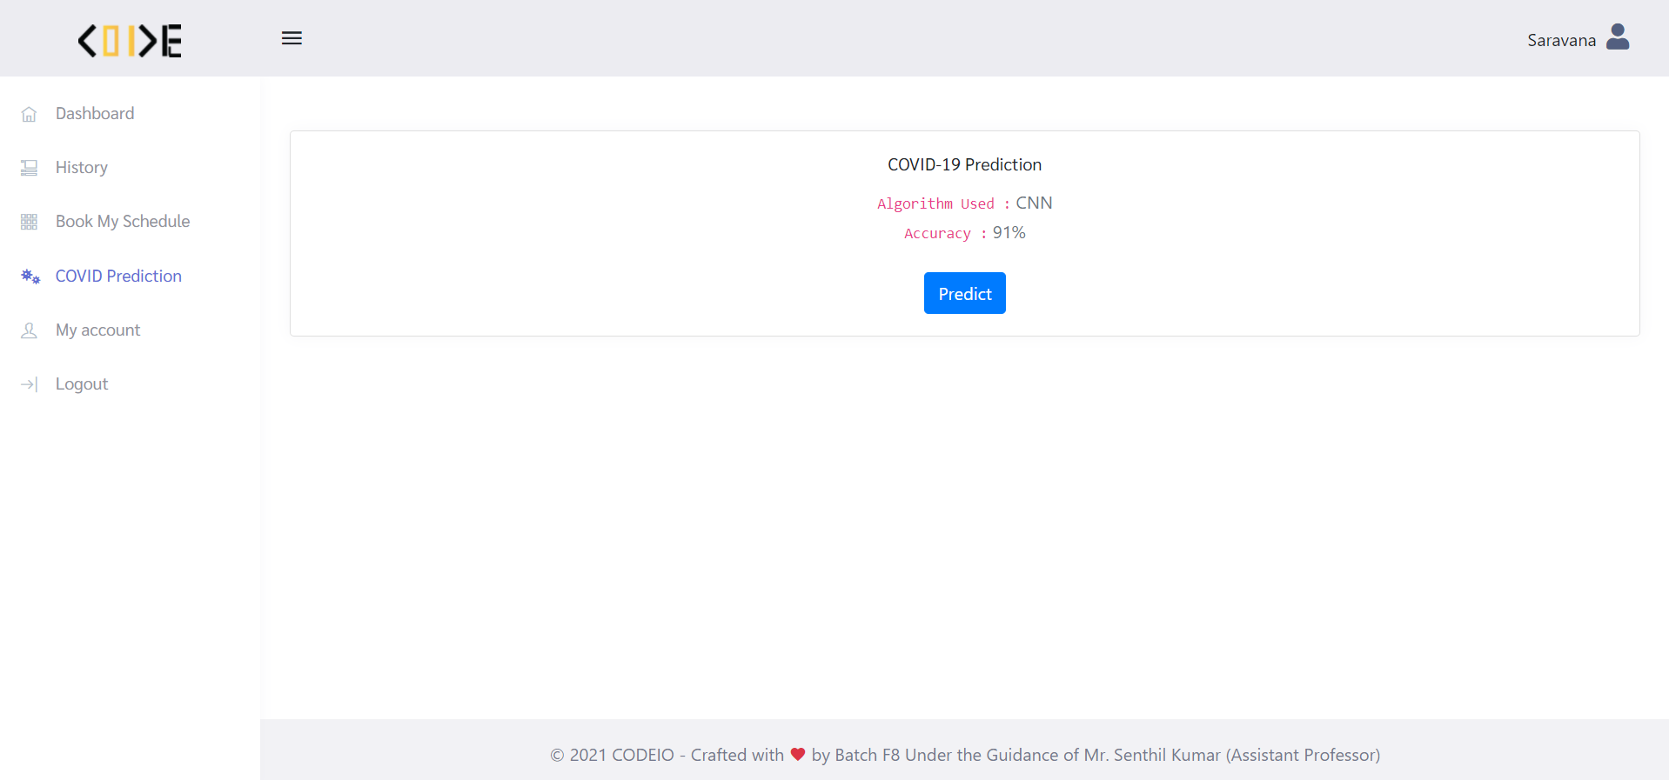
Fig 11: Shows the prediction page in patient Login

Slide 24
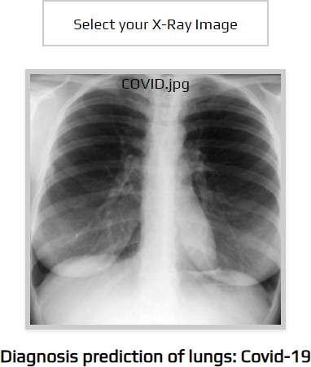
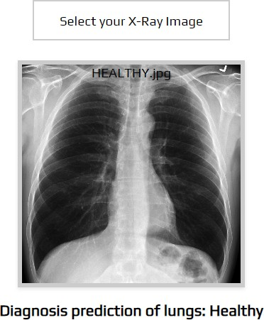
Fig 12:Shows the sample test cases for prediction

Slide 25
CONCLUSION
This project focuses mainly on enhancing communication between the Patient and Doctor. It also helps in COVID prediction with chest X-ray scan and Electronic medical records system to manage the health records of the patient such as medical prescriptions,X-ray images, Lab reports and etc.

Slide 26
REFERENCES
J. Latif, C. Xiao, S. Tu, S. U. Rehman, A. Imran and A. Bilal, "Implementation and Use of Disease Diagnosis Systems for Electronic Medical Records Based on Machine Learning: A Complete Review,“ IEEE Access, vol. 8, pp. 150489-150513, 2020.
Y. Sun and D. Zhang, ‘‘Diagnosis and analysis of diabetic retinopathy based on electronic health records,’’ IEEE Access, vol. 7, pp. 86115–86120, 2019.
T. S. Brisimi, T. Xu, T. Wang, W. Dai, W. G. Adams, and I. C. Paschalidis, ‘‘Predicting chronic disease hospitalizations from electronic health records: An interpretable classification approach,’’ Proc.IEEE, vol. 106, no. 4, pp. 690–707, Apr. 2018.
M. Alodadi, ‘‘Radiology clinical notes mining using weighted association rules,’’ in Proc. IEEE Int. Conf. Healthcare Informat. (ICHI), Aug. 2017, pp. 325.
E. F. Ohata et al., "Automatic detection of COVID-19 infection using chest X-ray images through transfer learning," in IEEE/CAA Journal of Automatica Sinica, vol. 8, no. 1, pp. 239-248, January 2021.
A. Narin, C. Kaya, and Z. Pamuk, “Automatic detection of coronavirus disease (COVID-19) using X-ray images and deep convolutional neural networks, arXiv: 2003.10849, 2020.

Slide 27
THANK YOU

